Slide 1
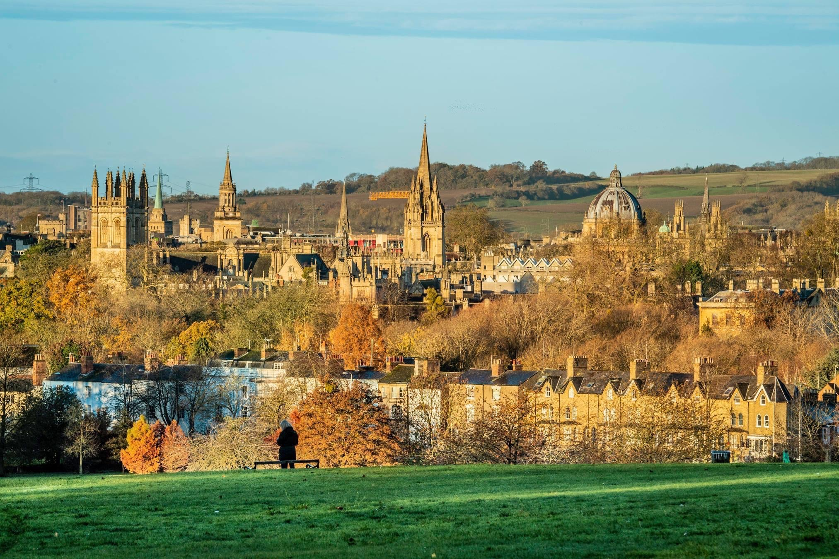

Slide 2
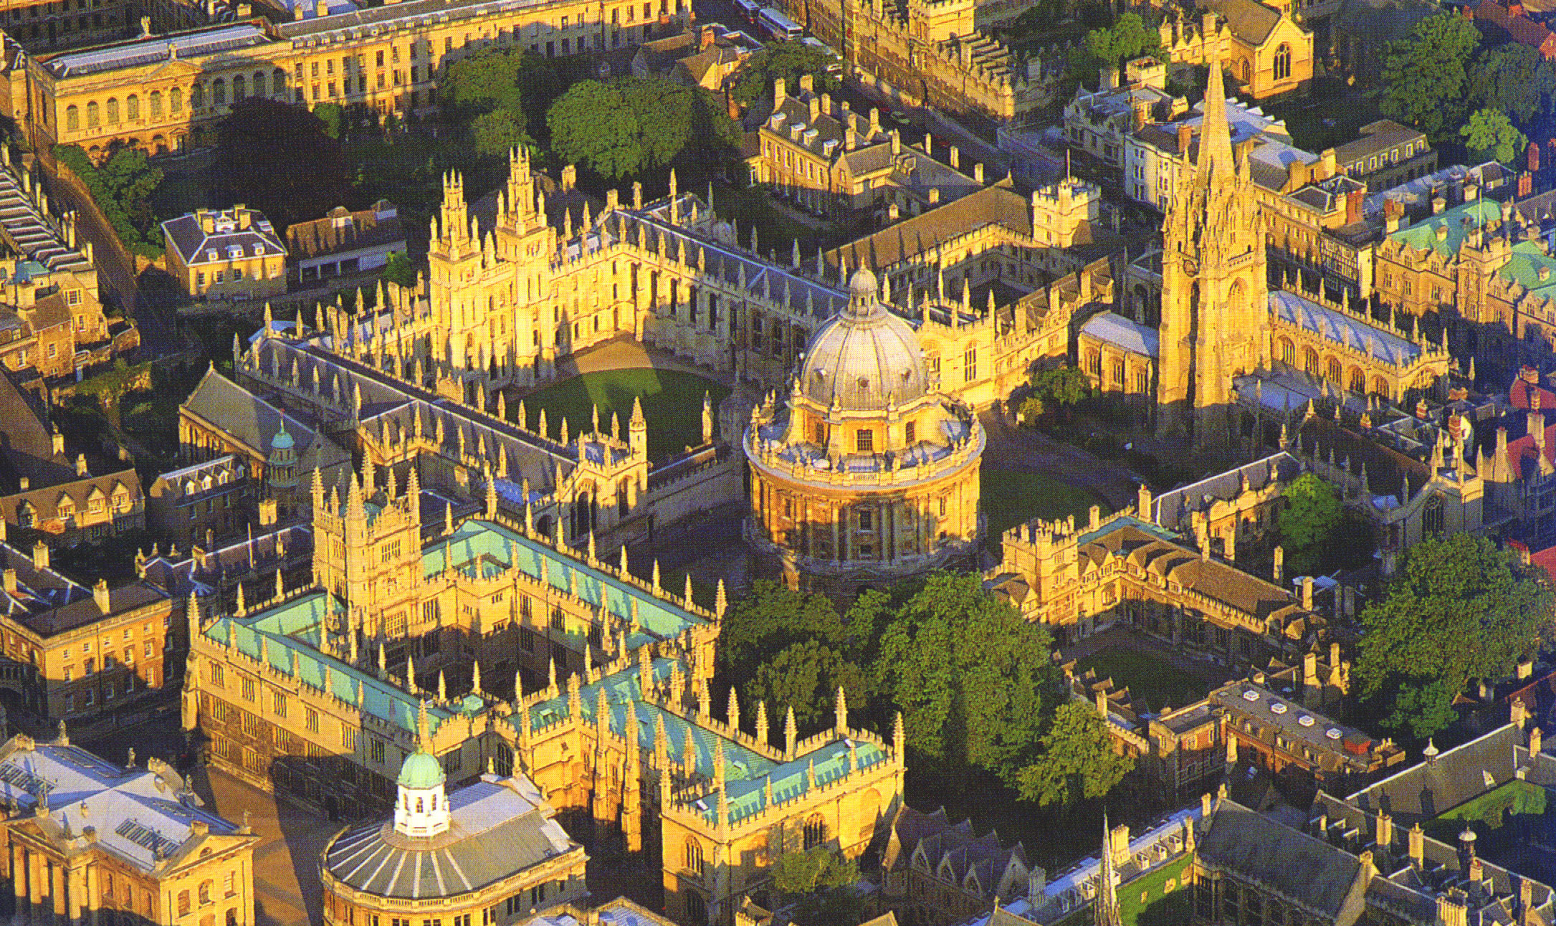
1509 – Brasenose
1517 – Corpus Christi
1546 – Christ Church
1554 – Trinity
1555 – St John’s
1571 – Jesus
1613 – Wadham
1624 - Pembroke
In 1660, University of Oxford
admitted – 400
BA - 240
MA - 150

Slide 4
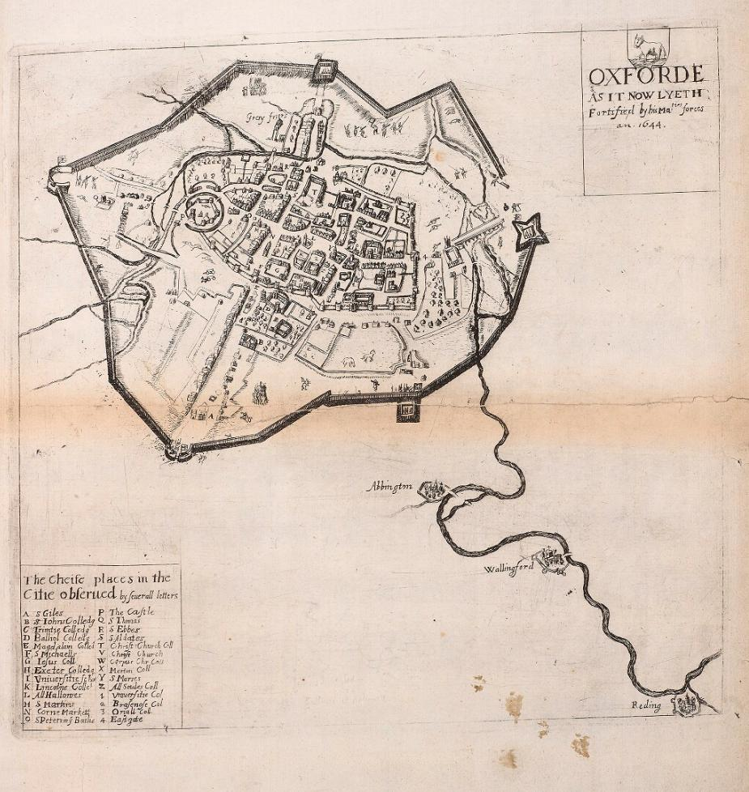

Slide 5
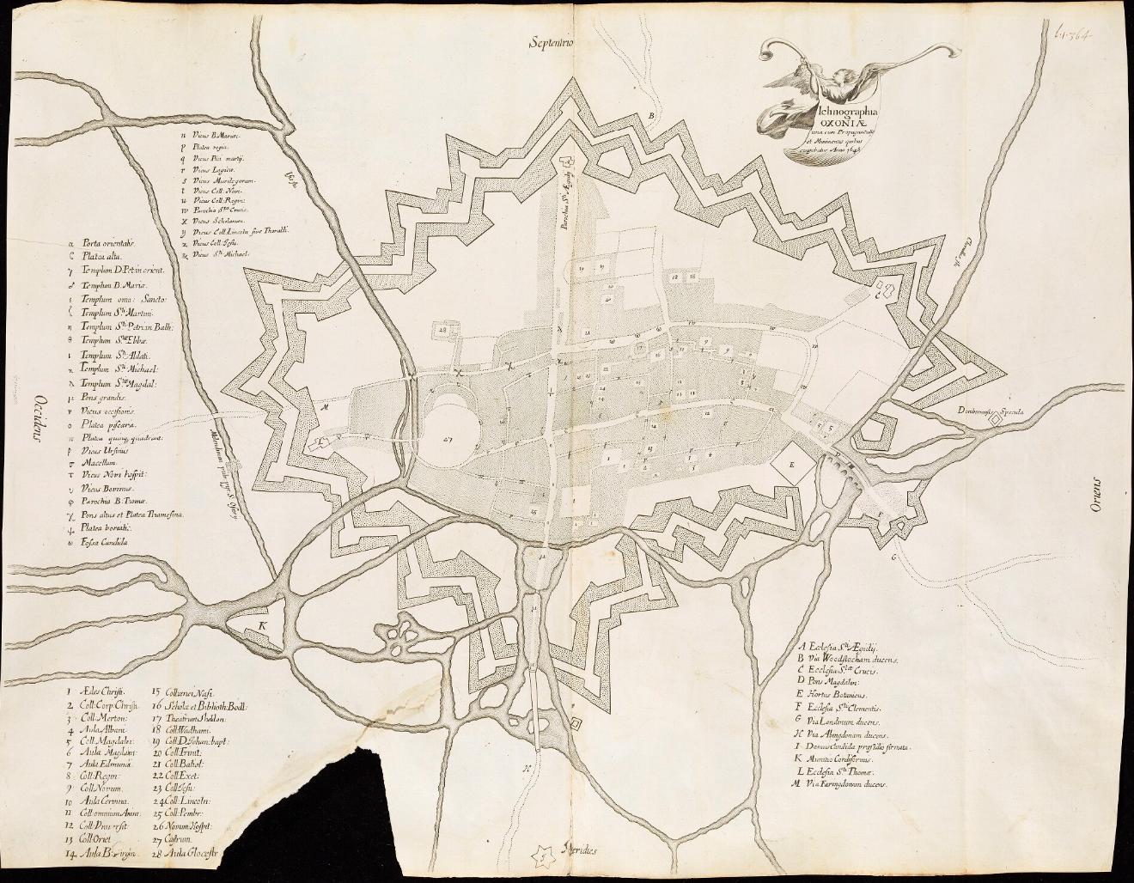

Slide 6
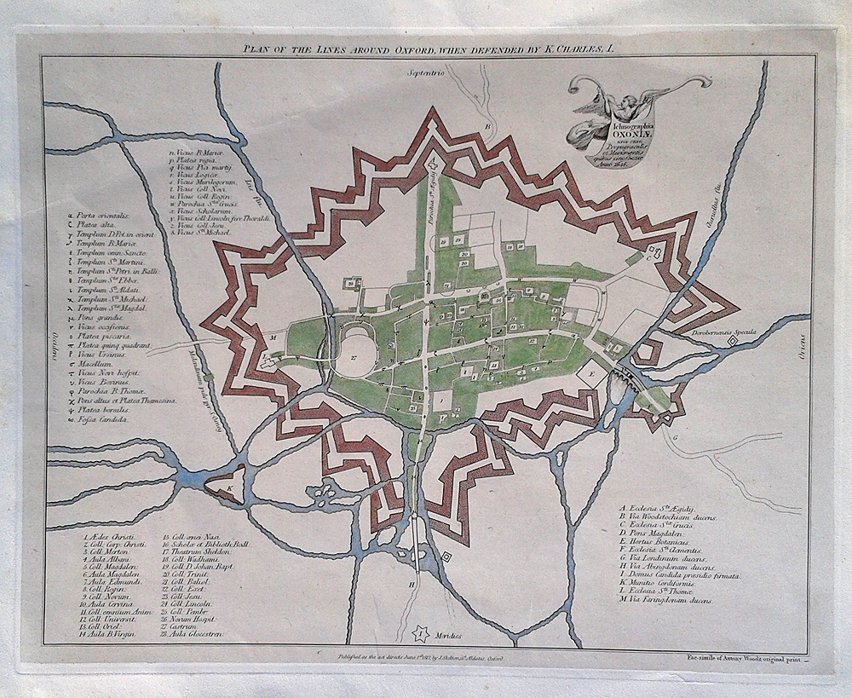

Slide 7
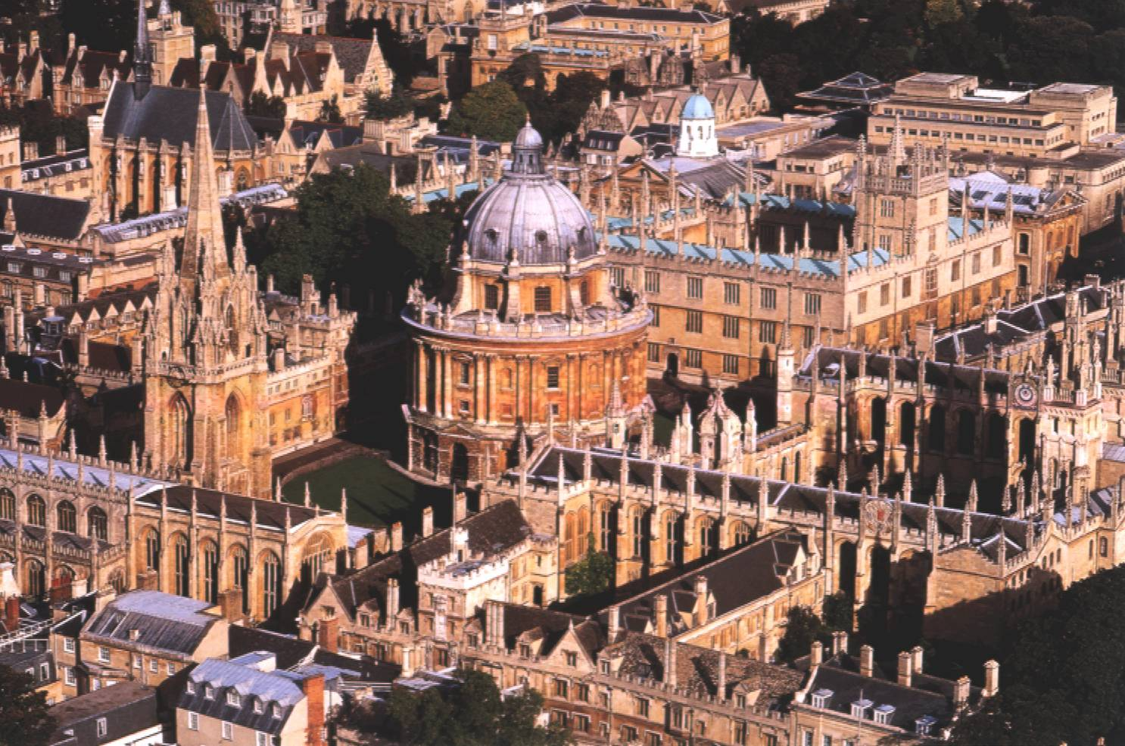
The Civil War,
The Protectorate and
Commonwealth,
and Restoration in Oxford

Slide 8
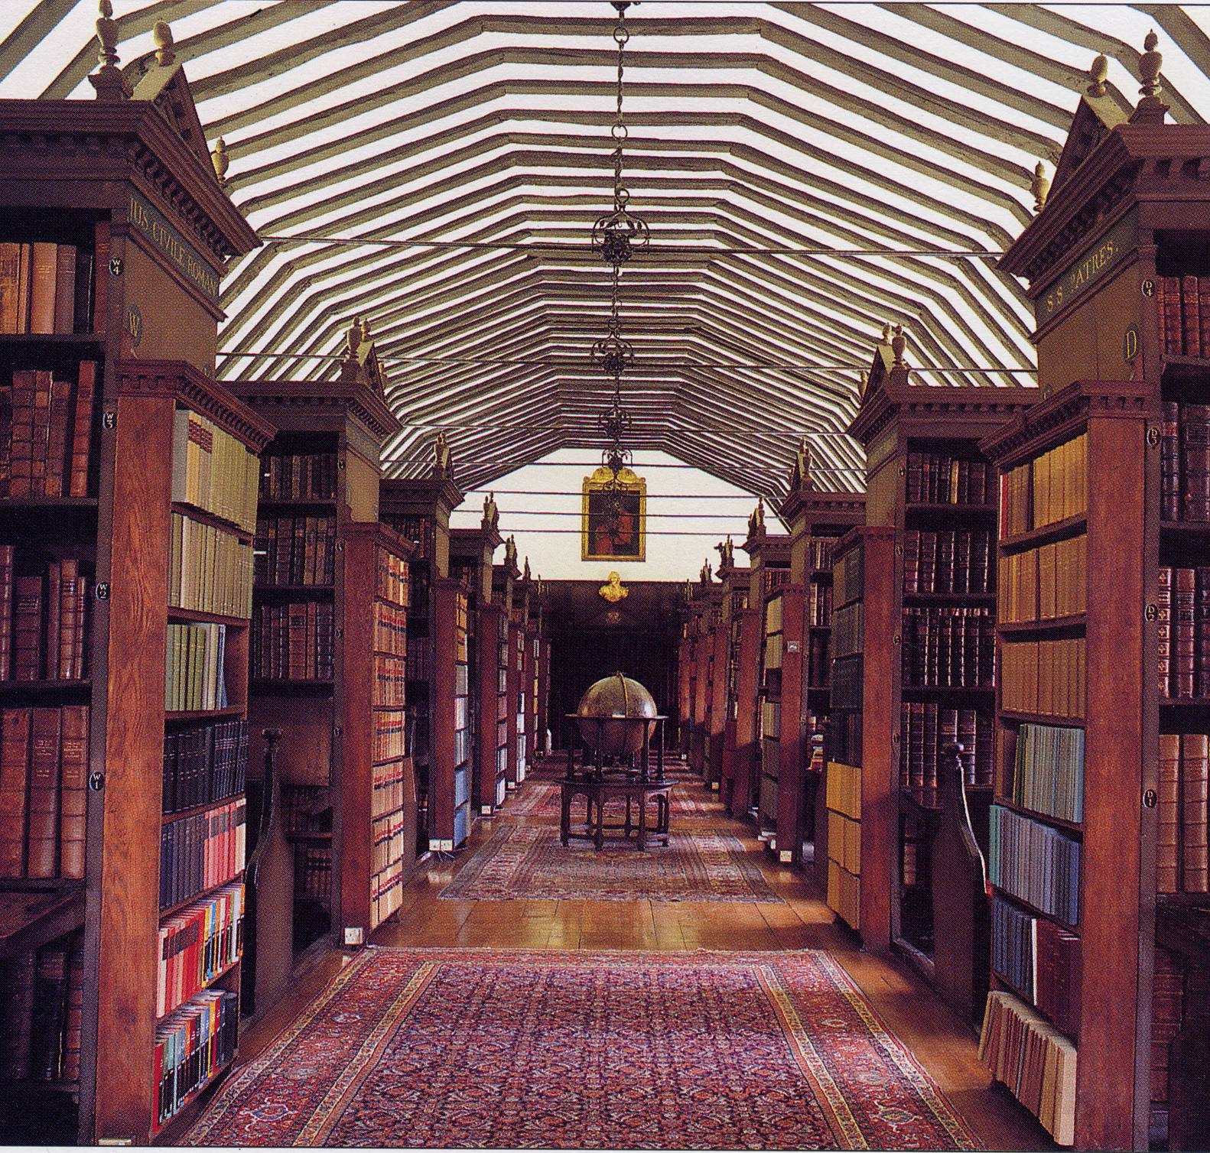
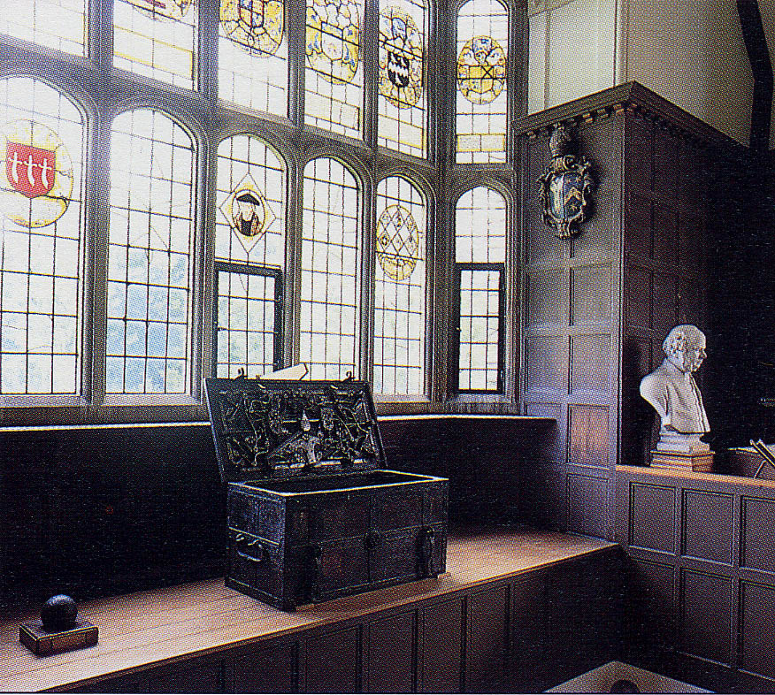

Slide 9
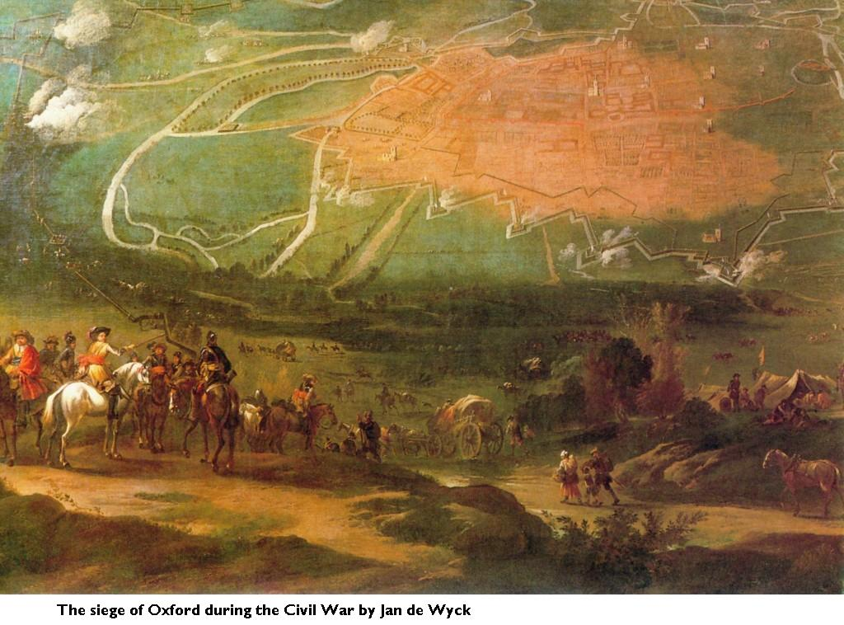

Slide 10
English Civil War – Siege of Oxford
1644 King’s Oxford Parliament (King at Christ Church, Queen at Merton)
First Siege 3rd June 1644 - King Charles I escaped
Second Siege 1645 Sir Thomas Fairfax was given orders to stop and pursue the king to Naseby
Third Siege 1646 June Sir Thomas Glenham surrendered Oxford to Fairfax
1649 Execution of Charles I.
1959 Death of Oliver Cromwell
1660 Restoration of Charles II

Slide 11
Chronology of Willis’s Life - 1
1621 Born 27 January at Great Bedwyn,
Wiltshire
1631 Death of Rachel, Willis’s mother
1636 Matriculated, Christ Church, Oxford
1639 BA, Oxford
1642 MA, Oxford
1643 Father and stepmother died of camp fever
1645 Enlisted in Dover’s regiment in the service
of the King
1646 Began medical practice

Slide 12
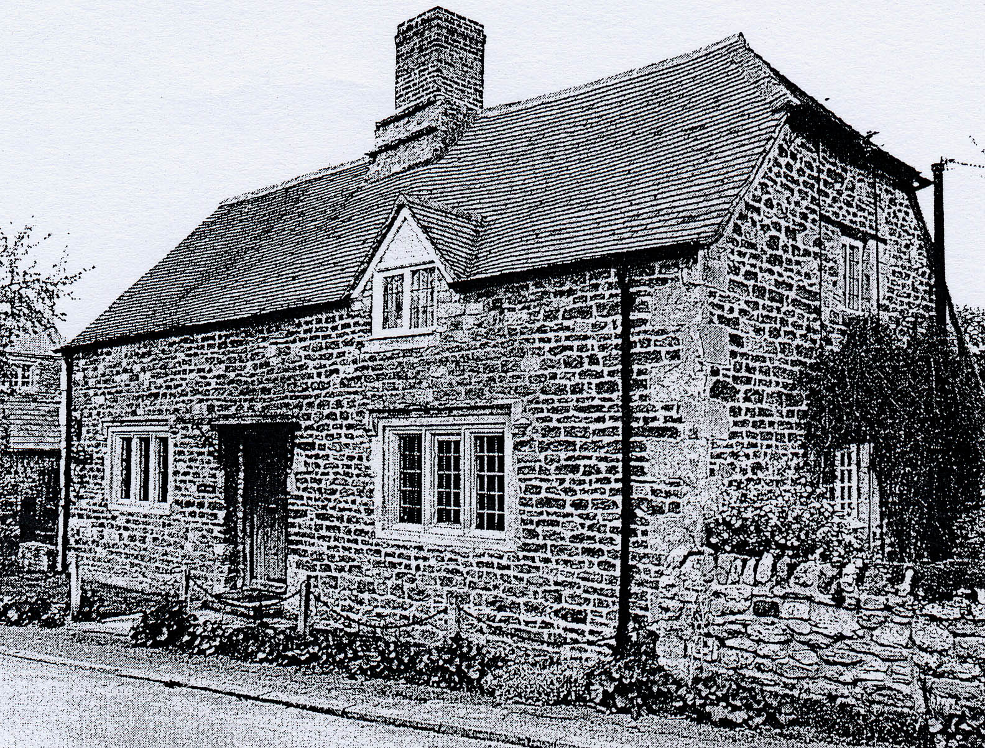
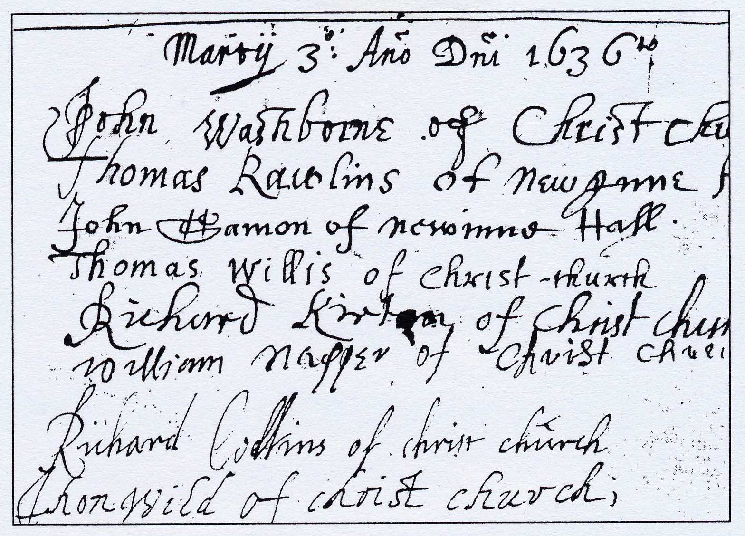
Chronology of Willis’s Life - 1
Trevor Hughes 1991
1621 Born 27 January at Great Bedwyn,
Wiltshire
1631 Death of Rachel, Willis’s mother
1636 Matriculated, Christ Church, Oxford
1639 BA, Oxford
1642 MA, Oxford
1643 Father and stepmother died of camp fever
1645 Enlisted in Dover’s regiment in the service
of the King
1646 Began medical practice

Slide 13
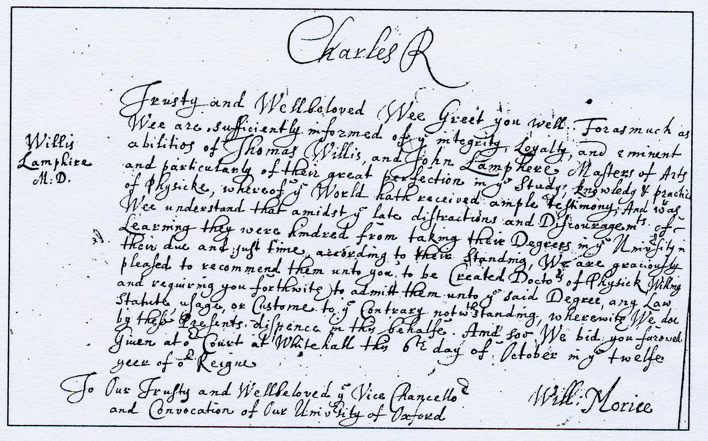
Chronology of Willis’s Life - 2
Trevor Hughes 1991
1646 Sir Thomas Glenham surrendered Oxford to Fairfax.
1649 Execution of Charles I.
1657 Married Mary Fell in St Michael’s Church, Oxford
1959 Death of Oliver Cromwell
1659 Publication of first book, Diatribae duae medico-philosophicae
1660 Restoration of Charles II - Elected Sedleian Professor of Natural Phylosophy, Oxford – Doctor of Medicine, by request of Charles II.
Notes:
Due to the special circumstances in Oxford he largely missed the stifling effect of a traditional medical education.

Slide 14
Chronology of Willis’s Life - 2
1646 Sir Thomas Glenham surrendered Oxford to Fairfax.
1649 Execution of Charles I.
1657 Married Mary Fell in St Michael’s Church, Oxford
1959 Death of Oliver Cromwell
1659 Publication of first book, Diatribae duae medico-philosophicae
1660 Restoration of Charles II - Elected Sedleian Professor of Natural Phylosophy, Oxford – Doctor of Medicine, by request of Charles II.

Slide 15
Chronology of Willis’s Life - 3
1663 Elected Fellow of Royal Society
1664 Published Cerebri Anatome. Elected Fellow of Royal College of Physicians
1667 Published Pathologiae Cerebri – Moved to London
1670 His wife Mary died, buried in Westminster Abby, published Affectionum quae dicuntur hystericae et hypochondriacae
1672 Married Elizabeth Calley, published Anima Brutorum
1674 Published Pharmaceuticae Rationalis (part 1)
1675 11 November Died at home in St Martin’s Lane, buried in Westminster Abbey

